Slide 1
Functional Business Systems
Business managers are moving from a tradition where they could avoid, delegate, or ignore decisions about IT to one where they cannot create a marketing, product, international, organization, or financial plan that does not involve such decisions.

Slide 2
Introduction
There are as many ways to use information technology in business as there are business activities to be performed, business problems to be solved, and business opportunities to be pursued.
What are the major ways information systems are used to support each of the functions of business?

Slide 3
In this session, we will discuss functional business systems, that is, a variety of types of information systems (transaction processing, management information, decision support, etc.) that support the business functions of
accounting,
finance,
marketing,
operations management, and
human resource management.
The next figure illustrates how information systems can be grouped into business function categories.

Slide 4
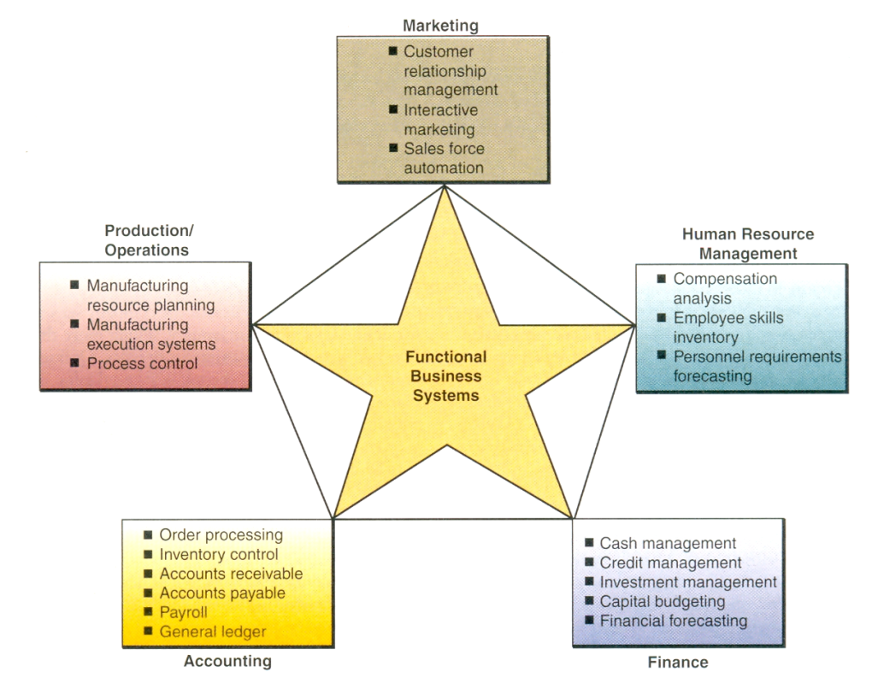

Slide 5
Marketing Systems
The business function of marketing is concerned with
the planning, promotion, and sale of existing products in existing markets, and
the development of new products and new markets to better attract and serve present and potential customers.
Marketing is thus a vital function in the operation of a business enterprise.
Business firms have increasingly turned to information technology to help them perform vital marketing functions in the face of the rapid changes of today's environment.

Slide 6
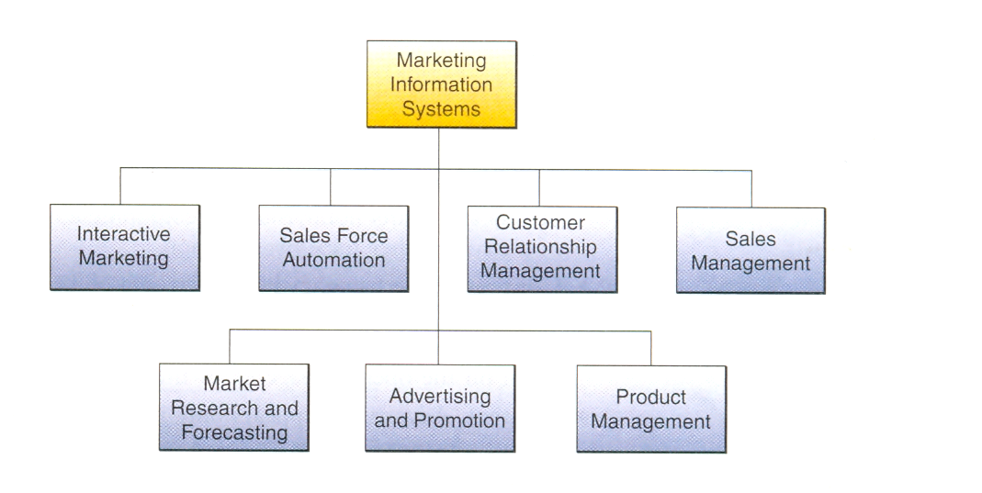
The figure below illustrates how marketing information systems provide information technologies that support major components of the marketing function.

Slide 7
For example,
Internet/intranet websites and services make an interactive marketing process possible where customers can become partners in creating, marketing, purchasing, and improving products and services.
Sales force automation systems use mobile computing and Internet technologies to automate many information processing activities for sales support and management.

Slide 8
Other marketing information systems assist marketing managers in
customer relationship management,
product planning, pricing, and other product management decisions,
advertising,
sales promotion and targeted marketing strategies, and
market research and forecasting.
Three of these marketing applications follow.

Slide 9
Interactive Marketing
The term interactive marketing has been coined to describe a customer focused marketing process that is based on using the Internet, intranets, and extranets to establish two-way transactions between a business and its customers or potential customers.
The goal of interactive marketing is to enable a company to profitably use those networks to attract and keep customers who will become partners with the business in creating, purchasing, and improving products and services.

Slide 10
In interactive marketing, customers are not just passive participants who receive media advertising prior to purchase, but are actively engaged in network-enabled proactive and interactive processes.
Interactive marketing encourages customers to become involved in
product development,
delivery, and
service issues.

Slide 11
This is enabled by various Internet technologies, including
chat and discussion groups,
Web forms and questionnaires,
instant messaging, and
e-mail correspondence.
Finally, the expected outcomes of interactive marketing are
a rich mixture of vital marketing data,
new product ideas,
volume sales, and
strong customer relationships.

Slide 12
Targeted Marketing
Targeted marketing has become an important tool in developing advertising and promotion strategies to strengthen a company's e-commerce initiatives, as well as its traditional business ventures.
As illustrated in the next figure, targeted marketing is an advertising and promotion management concept that includes five targeting components.

Slide 13
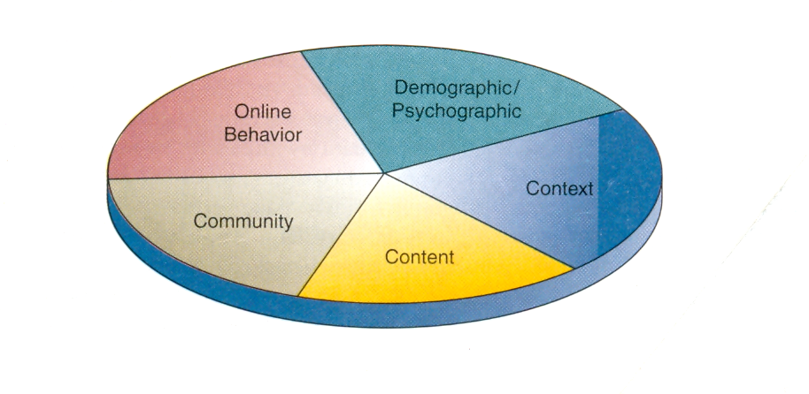

Slide 14
Community. Companies can customize their Web advertising messages and promotion methods to appeal to people in specific communities.
They can be communities of interest, such as
virtual communities of online sporting enthusiasts or
arts and crafts hobbyists, or
geographic communities formed by the websites of a city or other local organization.

Slide 15
Content. Advertising such as electronic billboards or banners can be placed on a variety of selected websites, in addition to a company's website.
The content of these messages is aimed at the targeted audience.
An ad for a product campaign on the opening page of an Internet search engine is a typical example.

Slide 16
Context. Advertising appears only in Web pages that are relevant to the content of a product or service.
So advertising is targeted only at people who are already looking for information about a subject matter (vacation travel, for example) that is related to a company's products (car rental services, for example).
Demographic/Psychographic. Web marketing efforts can be aimed only at specific types or classes of people: unmarried, twenty-something, middle income, male college graduates, for example.

Slide 17
Online Behavior. Advertising and promotion efforts can be tailored to each visit to a site by an individual.
This strategy is based on a variety of tracking techniques, such as Web "cookie" files recorded on the visitor's disk drive from previous visits.
This enables a company to track a person's online behavior at a website so marketing efforts (such as coupons redeemable at retail stores or e-commerce websites) can be targeted to that individual at each visit to their website.

Slide 18
Sales Force Automation
Increasingly, computers and the Internet are providing the basis for sales force automation.
In many companies, the sales force is being outfitted with
notebook computers,
Web browsers, and
sales contact management software
that connect them to marketing websites on the Internet, extranets, and their company intranets.

Slide 19
This not only increases the personal productivity of salespeople, but dramatically speeds up the capture and analysis of sales data from the field to marketing managers at company headquarters.
In return, it allows marketing and sales management to improve the delivery of information and the support they provide to their salespeople.
Therefore, many companies are viewing sales force automation as a way to gain a strategic advantage in sales productivity and marketing responsiveness.

Slide 20
For example, salespeople use their PCs to record sales data as they make their calls on customers and prospects during the day.
Then each night, sales reps in the field can connect their computers by modem and telephone links to the Internet and extranets, which can access intranet or other network servers at their company.
Then, they can upload information on sales orders, sales calls, and other sales statistics, as well as send electronic mail messages and access website sales support information.
In return, the network servers may download product availability data, prospect lists of information on good sales prospects, and e-mail messages.

Slide 21
Manufacturing Systems
Manufacturing information systems support the production/operations function that includes all activities concerned with the planning and control of the processes producing goods or services.
Thus, the production/operations function is concerned with the management of the operational processes and systems of all business firms.

Slide 22
Information systems used for operations management and transaction processing support all firms that must plan, monitor, and control
inventories,
purchases, and
the flow of goods and services.
Therefore, firms such as transportation companies, wholesalers, retailers, financial institutions, and service companies must use production/operations information systems to plan and control their operations.

Slide 23
Computer ­Integrated Manufacturing
Once upon a time, manufacturers operated on a simple build-to-stock model. They built 100 or 100,000 of an item and sold them via distribution networks. They kept track of the stock of inventory and made more of the item once inventory levels dipped below a threshold. Rush jobs were both rare and expensive, and configuration options limited. Things have changed. Concepts like just-in-time inventory, build-to-order (BTO) manufacturing, end-to-end supply chain visibility, the explosion in contract manufacturing, and the development of Web-based e-business tools for collaborative manufacturing have revolutionized plant management.

Slide 24
CIM supports the concepts of
flexible manufacturing systems,
agile manufacturing, and
total quality management.
A flexible manufacturing system is a manufacturing system in which there is some amount of flexibility that allows the system to react in case of changes, whether predicted or unpredicted. E.g. Bicycle manufacturing. Machines and computerized systems can be configured to manufacture a variety of parts and handle changing levels of production
Agile manufacturing is a term applied to an organization that has created the processes, tools, and training to enable it to respond quickly to customer needs and market changes while still controlling costs and quality.
Total quality management consists of organization-wide efforts to "install and make permanent climate where employees continuously improve their ability to provide on demand products and services that customers will find of particular value."
Implementing such manufacturing concepts enables a company to quickly respond to and fulfill customer requirements with high-quality products and services.

Slide 25
ClM is an overall concept that stresses that the objectives of computer-based systems in manufacturing must be to:
Simplify (reengineer) production processes, product designs, and factory organization as a vital foundation to automation and integration.
Automate production processes and the business functions that support them with computers, machines, and robots.
Integrate all production and support processes using computer networks, cross-functional business software, and other information technologies.

Slide 26
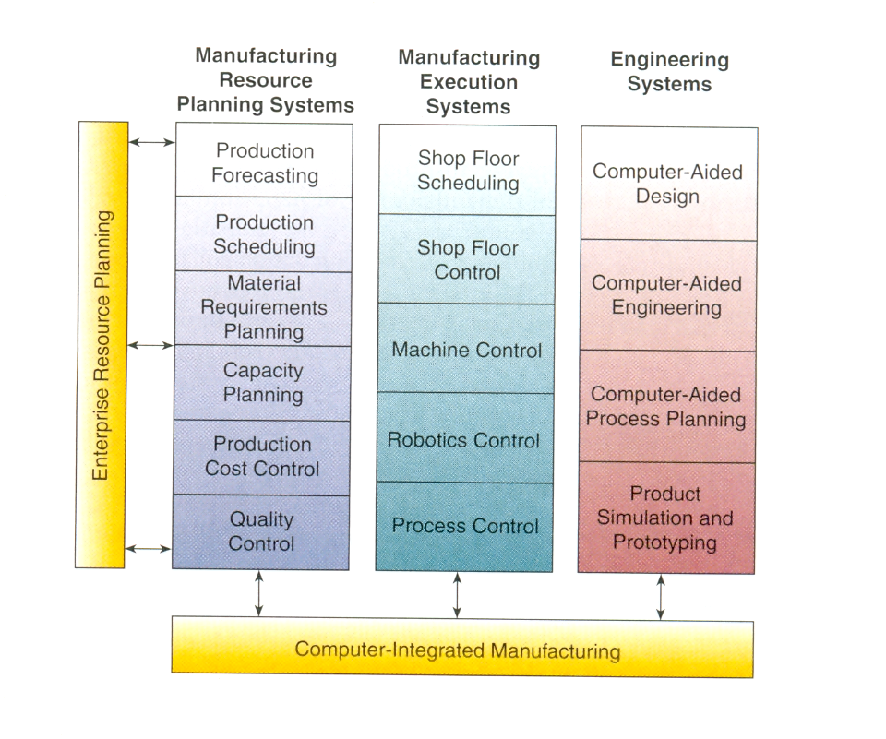
As the figure below depicts, a variety of manufacturing information systems, many of them Web-enabled, are used to support computer-integrated manufacturing (CIM).

Slide 27
Computers are used to help engineers design
better products using both computer-aided engineering (CAE) and computer-aided design (CAD) systems, and
better production processes with computer-aided process planning.
Computers are also used to help
plan the types of material needed in the production process, which is called material requirements planning (MRP), and
to integrate MRP with
production scheduling and
shop floor operations,
which is known as manufacturing Resource planning.
Many of the processes within manufacturing resource planning systems are included in the manufacturing module of enterprise resource planning (ERP) software which is discussed later.

Slide 28
Computer-aided manufacturing (CAM) systems are those that automate the production process by
monitoring and controlling the production process in a factory (manufacturing execution systems) or by
directly controlling a
physical process (process control),
a machine tool (machine control), or
machines with some humanlike work capabilities (robots).
Manufacturing execution systems (MES) monitor performance of factory floor operations.
They monitor, track, and control
materials, equipment, personnel, instructions and specifications, and production facilities.

Slide 29
MES includes
shop floor scheduling and control,
machine control,
robotics control, and
process control systems.
Process control is the use of computers to control an ongoing physical process.
Process control computers control physical processes in
petroleum refineries,
cement plants,
steel mills,
chemical plants,
food product manufacturing plants,
pulp and paper mills,
electric power plants, and so on.

Slide 30
A process control computer system requires the use of special sensing devices that measure physical phenomena such as temperature or pressure changes.
These continuous physical measurements are converted to digital form by analog-to-digital converters and relayed to computers for processing.
Machine control is the use of computers to control the actions of machines - popularly called numerical control.

Slide 31
Human Resource Systems
The human resource management (HRM) function involves the recruitment, placement, evaluation, compensation, and development of the employees of an organization.
The goal of HRM is the effective and efficient use of the human resources of a company.
Thus, human resource information systems are designed to support
planning to meet the personnel needs of the business,
development of employees to their full potential, and
control of all personnel policies and programs.

Slide 32
Originally, businesses used computer-based information systems to
(1) produce paychecks and payroll reports,
(2) maintain personnel records, and
(3) analyze the use of personnel in business operations.

Slide 33
Many firms have gone beyond these traditional personnel management functions and have developed human resource information systems (HRIS) that also support
(1) recruitment, selection, and hiring;
(2) job placement;
(3) performance appraisals;
(4) employee benefits analysis;
(5) training and development; and
(6) health, safety, and security.

Slide 34
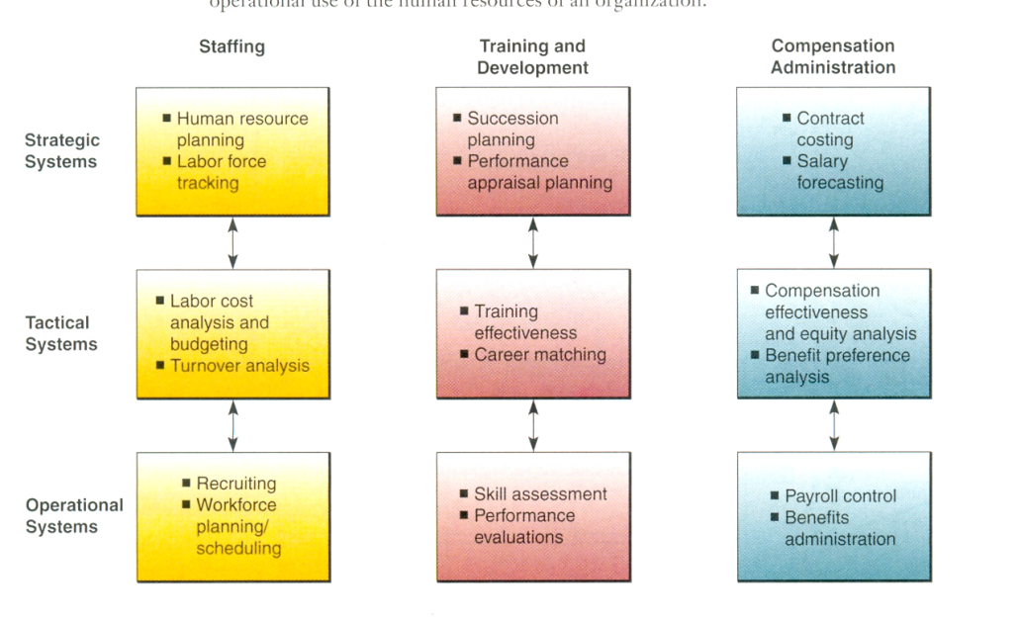

Slide 35
HRM and the Internet
The Internet has become a major force for change in human resource management.
E.g., online HRM systems may involve recruiting for employees through recruitment sections of corporate websites.
Companies may use
commercial recruiting services and databases on the World Wide Web,
post messages in selected Internet newsgroups, and
communicate with job applicants via e-mail.

Slide 36
The Internet has a wealth of information and contacts for both employers and job hunters.
E.g. There are websites full of reports, statistics, and other useful HRM information, such as job reports by industry, or listings of the top recruiting markets by industry and profession.
E.g. Monster.com, HotJobs.com, and Jobweb.org

Slide 37
HRM and Corporate Intranets
Intranet technologies allow companies to process most common HRM applications over their corporate intranets.
Intranets allow the HRM department to provide around the clock services to their customers: the employees.
They can also disseminate valuable information faster than through previous company channels.
Intranets can collect information online from employees for input to their HRM files, and they can enable managers and other employees to perform HRM tasks with little intervention by the HRM department.

Slide 38
For example, employee self-service (ESS) intranet applications allow employees to
view benefits,
enter travel and expense reports,
verify employment and salary information,
access and update their personal information, and
enter data that has a time constraint to it.

Slide 39
Another benefit of the intranet is that it can serve as a superior training tool.
Employees can
easily download instructions and processes to get the information or education they need.
view training videos over the intranet on demand.
Employees can also use their corporate intranets to produce automated pay sheets.
These electronic forms have made viewing, entering, and adjusting payroll information easy for both employees and HRM professionals.

Slide 40
Accounting Systems
Accounting information systems are the oldest and most widely used information systems in business.
They record and report business transactions and other economic events.
Computer-based accounting systems record and report the flow of funds through an organization on a historical basis and produce important financial statements such as balance sheets and income statements.
Such systems also produce forecasts of future conditions such as projected financial statements and financial budgets.
A firm's financial performance is measured against such forecasts by other analytical accounting reports.

Slide 41
Operational accounting systems emphasize legal and historical record-keeping and the production of accurate financial statements.
Typically, these systems include transaction processing systems such as
order processing,
inventory control,
accounts receivable,
accounts payable,
payroll, and
general ledger systems.

Slide 42
Common Business Accounting Systems
• Order Processing
Captures and processes customer orders and produces data for inventory control and accounts receivable.
• Inventory Control
Processes data reflecting changes in inventory and provides shipping and reorder information.
• Accounts Receivable
Records amounts owed by customers and produces customer invoices, monthly customer statements, and credit
management reports.
• Accounts Payable
Records purchases from, amounts owed to, and payments to suppliers, and produces cash management reports.
• Payroll
Records employee work and compensation data and produces paychecks and other payroll documents and reports.
• General Ledger
Consolidates data from other accounting systems and produces the periodic financial statements and reports of the business.
.

Slide 43
Management accounting systems focus on the planning and control of business operations.
They emphasize
cost accounting reports,
the development of financial budgets and projected financial statements, and
analytical reports comparing actual to forecasted performance.
The next figure illustrates the interrelationships of several important accounting information systems commonly computerized by both large and small businesses.

Slide 44
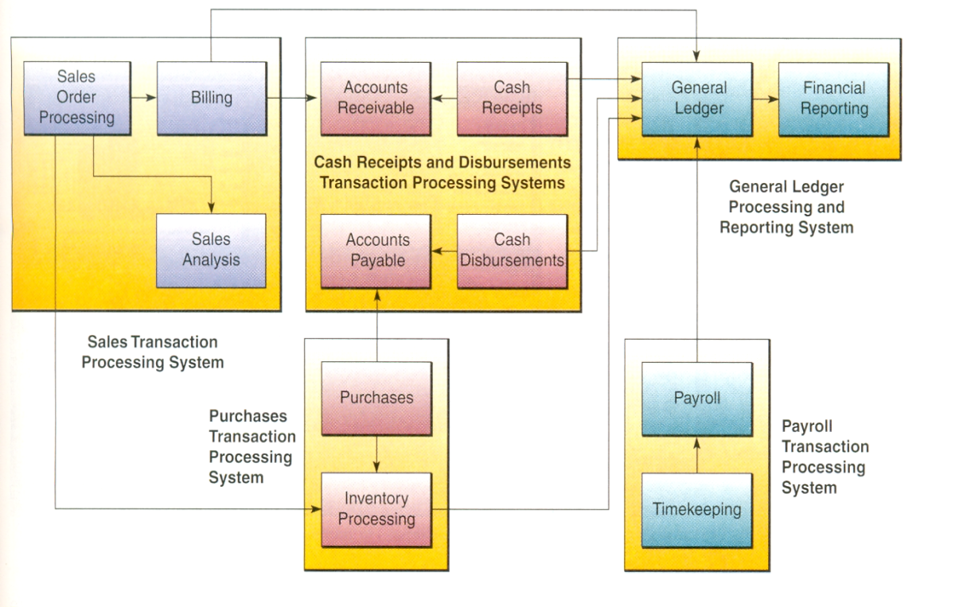
Many accounting software packages are available for these applications

Slide 45
Online Accounting Systems
Accounting information systems are being transformed by Internet technologies.
Using the Internet and other networks changes how accounting information systems monitor and track business activity.
The online, interactive nature of such networks calls for new forms of transaction documents, procedures, and controls.
This particularly applies to systems like
order processing,
inventory control,
accounts receivable, and
accounts payable.

Slide 46
These systems are directly involved in the processing of transactions between a business and its customers and suppliers.
So naturally, many companies are using Internet and other network links to these trading partners for such online transaction processing systems.

Slide 47
Financial Management Systems
Computer-based financial management systems support business managers and professionals in decisions concerning
(1) the financing of a business and
(2) the allocation and control of financial resources within a business.
Major financial management system categories include
cash and investment management,
capital budgeting,
financial forecasting, and
financial planning.

Slide 48
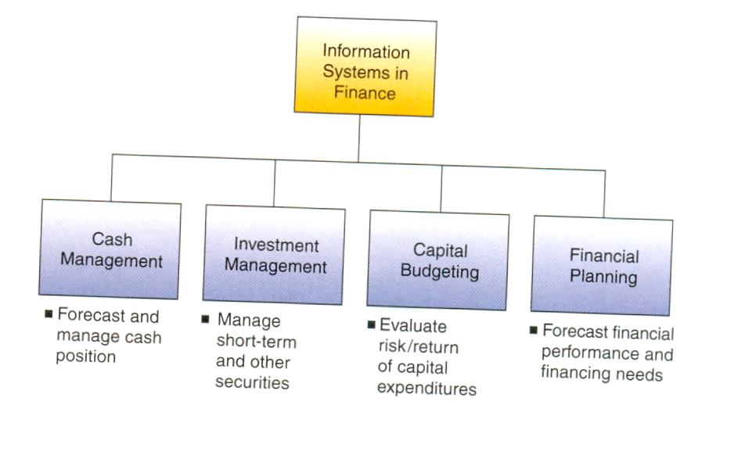

Slide 49
For example, the capital budgeting process involves evaluating the profitability and financial impact of proposed capital expenditures.
Long-term expenditure proposals for facilities and equipment can be analyzed using a variety of return on investment (ROI) evaluation techniques.
This application makes heavy use of spreadsheet models that incorporate present value analysis of expected cash flows and probability analysis of risk to determine the optimum mix of capital projects for a business.

Slide 50
Financial analysts also typically use electronic spreadsheets and other financial planning software to evaluate the present and projected financial performance of a business.
They also help determine the financing needs of a business and analyze alternative methods of financing.
Financial analysts use financial forecasts concerning the economic situation, business operations, types of financing available, interest rates, and stock and bond prices to develop an optimal financing plan for the business.

Slide 51
Electronic spreadsheet packages, DSS software, and Web-based groupware can be used to build and manipulate financial models.
Financial analysts and managers explore and evaluate their financing and investment alternatives by using what-if and goal-seeking techniques.

